Slide 1
Oracle9i Database
数据库启动与关闭

Slide 2
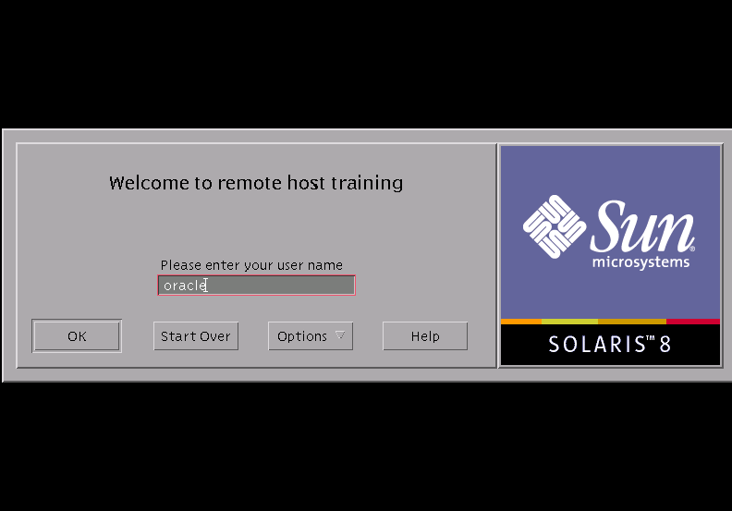
数据库启动

Slide 3
Oracle9i数据库在 Unix下的启动
$SQLPLUS /NOLOG
SQL>CONNECT sys/change_on_install AS SYSDBA
$sqlplus "/as sysdba"
SQL*Plus: Release 9.2.0.1.0 - Production on Thu Aug 22 20:04:19 2002
Copyright (c) 1982, 2002, Oracle Corporation. All rights reserved.
Connected to:
Oracle9i Enterprise Edition Release 9.2.0.1.0 - Production
With the Partitioning, OLAP and Oracle Data Mining options
JServer Release 9.2.0.1.0 - Production
SQL>startup
ORACLE instance started.
Total System Global Area 61611980 bytes
Fixed Size 65484 bytes
Variable Size 54919168 bytes
Database Buffers 6553600 bytes
Redo Buffers 73728 bytes
Database mounted.
Database opened.

Slide 4
Oracle9i数据库在 Windows NT下的启动
C:\>sqlplus "/as sysdba"
SQL*Plus: Release 9.2.0.1.0 - Production on 星期二 10月 8 16:35:07 2002
Copyright (c) 1982, 2002, Oracle Corporation. All rights reserved.
连接到:
Oracle9i Enterprise Edition Release 9.2.0.1.0 – Production
With the Partitioning, OLAP and Oracle Data Mining options
JServer Release 9.2.0.1.0 - Production
SQL> startup
ORACLE 例程已经启动。
Total System Global Area 51452388 bytes
Fixed Size 453092 bytes
Variable Size 46137344 bytes
Database Buffers 4194304 bytes
Redo Buffers 667648 bytes
数据库装载完毕。
数据库已经打开。

Slide 5
启动监听进程Listener
$lsnrctl start
TNSLSNR for Solaris: Version 9.0.1.1.1 - Production on 06-OCT-2001 12:27:54
Copyright (c) 1991, 2001, Oracle Corporation. All rights reserved.
Starting tnslsnr: please wait…
TNSLSNR for Solaris: Version 9.0.1.1.1 - Production
System parameter file is /home2/app/oracle/product/9.0.1/network/admin/listener.ora
Log messages written to /home2/app/oracle/product/9.0.1/network/log/listener.log
Listening on: (DESCRIPTION=(ADDRESS=(PROTOCOL=ipc)(PIPENAME=\\.\pipe\EXTPROC0ipc)))
Listening on: (DESCRIPTION=(ADDRESS=(PROTOCOL=tcp)(HOST=sun4500)(PORT=1521)))

Slide 6
启动监听进程Listener
Connecting to (DESCRIPTION=(ADDRESS=(PROTOCOL=IPC)(KEY=EXTPROC0)))
STATUS of the LISTENER
------------------------
Alias LISTENER
Version TNSLSNR for Solaris: Version 9.0.1.1.1 - Production
Start Date 06-OCT-2001 12:27:56
Uptime 0 days 0 hr. 0 min. 2 sec
Trace Level off
Security OFF
SNMP OFF
Listener Parameter File /home2/app/oracle/product/9.0.1/network/admin/listener.ora
Listener Log File /home2/app/oracle/product/9.0.1/network/log/listener.log
Listening Endpoints Summary…
(DESCRIPTION=(ADDRESS=(PROTOCOL=ipc)(PIPENAME=\\.\pipe\EXTPROC0ipc)))
(DESCRIPTION=(ADDRESS=(PROTOCOL=tcp)(HOST=sun4500)(PORT=1521)))
Services Summary…
Service "PLSExtProc" has 1 instance(s).
Instance "PLSExtProc", status UNKNOWN, has 1 handler(s) for this service…
Service "ora9i" has 1 instance(s).
Instance "ora9i", status UNKNOWN, has 1 handler(s) for this service…
The command completed successfully

Slide 7

Oracle9i数据库启动要求
Oracle9i引入了服务器参数文件spfile的概念，在数据库启动时，系统缺省使用spfile参数启动数据库。
如果没有spfile参数文件，则使用pfile启动数据库。
如果两个文件同时存在，则系统优先使用spfile。
如果没有spfile、pfile则出现错误。

Slide 8
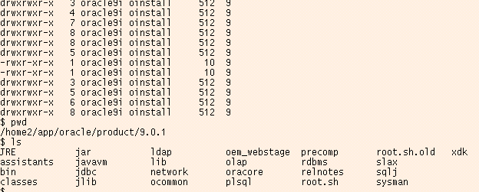

Slide 9
Oracle启动过程
3
OPEN
数据库打开
2
MOUNT
数据库安装
1
NOMOUNT
启动实例
0
SHUTDOWN

Slide 10
数据库关闭
$sqlplus /nolog
SQL*Plus: Release 9.0.1.0.1 - Production on Sat Oct 6 12:19:20 2001
(c) Copyright 2001 Oracle Corporation. All rights reserved.
SQL> connect sys/manager as sysdba
Connected.
SQL> shutdown immediate
Database closed.
Database dismounted.
ORACLE instance shut down.
SQL>

